Slide 1


Welcome to
Scrapवाला
1- Aviral Kumar Singhal
2- Dipali Sham Patil
3- Pranali Gaware
4- Rohini Amale
SUBMITTED
BY:

Slide 2
INTRODUCTION
Scrap Wala Web Application is a common web-based platform for common people as well as for any organization/Industries.
This application Provides faster and reliable response as well as ensures the best solution.
Here, the user will schedule the scrap collection place, date and time. The scrap collector will come according to the scheduled meeting and will collect all the scrap which we are willing to sell.

Slide 3
The application is a door-to-door scrap collecting and recycling service. It also provides different sectors which include individual House, Society, Organization, and Industries.
The scrap service provider is one of the most effective uses of the World Wide Web.
The primary goal of an e-scrap service site is to make scrap free environment.

Slide 4


Why
Scrapवाला?

Slide 5
Why
Scrapवाला?
Best Rates
Convenience
We provide the best value for your scrap from our network of Recyclers.
Doorstep pickup according to user's convenient date & time.
B
C
E
T
Eco-friendly
Trust
We ensure responsible recycling of your scrap items.
Trained & Verified Pickup Staff with Swapeco Smart Weighing Scale

Slide 6


Who can use Scrapवाला?
FOR HOUSEHOLDS
FOR BUSINESSES
On-Demand Doorstep Pickups
Accurate Digital Weighing
Safety (Trained & Verified Staff)
Formal Payments & Documentation
Sustainability Reports
Competitive Prices

Slide 7


FrontEnd Used
REACT JS
The React. js framework is an open-source JavaScript framework and library developed by Facebook.

Slide 8

Why ReactJs?
Compared to other frontend frameworks, the React code is easier to maintain and is flexible due to its modular structure.
It's used for building interactive user interfaces and web applications quickly and efficiently with significantly less code than you would with vanilla JavaScript.
1
2
Deploying React is fairly easy to accomplish if one have some basic knowledge of JavaScript.
React, compared to other popular frontend frameworks like Angular & Vue, is much easier to learn
React comes with JSX, an optional syntax extension, which makes it possible to write your own components.
3
4
5

Slide 9

BackEnd Used
SPRING FRAMEWORK
Spring Framework is a Java platform that provides comprehensive infrastructure support for developing Java applications. Spring handles the infrastructure so you can focus on your application.

Slide 10
Why Spring Framework?
Spring ensures easy and effective communication with databases as it has DAO (Data Access Object) functionality which is meant to read and write data to a database. With the support of DAO in Spring, data access related technologies such as Hibernate, JDBC, and JPA make it easier to communicate with databases.
Spring Boot uses Boot Initializer to compile the source language.
1
2
While Spring Boot can use WAR (web application resource) files, they are not necessary. Instead, Spring Boot can rely on JAR (Java resource).
Dependency Injection helps in decreasing coupling and dependency between classes in Spring projects so that the program becomes maintainable and reusable.
Spring improves coding efficiency and reduces overall application development time because it is lightweight
3
4
5

Slide 11

Database Used
MYSQL
MySQL, the most popular Open-Source SQL database management system, is developed, distributed, and supported by Oracle Corporation.

Slide 12
Why MySql?
Database Software is a client/server system that consists of a multithreaded SQL server that supports different back ends, several different client programs and libraries, administrative tools
structured collection
of data
1
2
Database Server is very fast, reliable, scalable, and easy to use
Its connectivity, speed, and security make MySQL Server highly suited for accessing databases on the Internet.
Anybody can download the MySQL software from the Internet and use it without paying anything
3
4
5

Slide 13
1
ADMIN
Stores the data of Admin
2
USER
Stores the data of User
Tables in Database
3
EMPLOYEE
Stores the data of Employee
4
SCRAPS
Stores the data of Scraps
5
SCRAPPRODUCTS
Stores the information of Scraps and User

Slide 14
6
LOGINS
Stores the data of whoever is logged in either User or Admin
Tables in Database
7
PICKUPS
Stores the of Pickup scheduled for the scrap.
EMPLOYEE

Slide 15




How Scrapवाला Works?
01
03
SCHEDULE A PICKUP
05
LOGIN
OTP VERIFICATION
PICKUP AT YOUR ADDRESS
SELECT A PRODUCT
02
04

Slide 16





End to End Flow of User
OTP Verification of User
OTP
Login of User
User Logout
LOGOUT
LOGIN
Pickup Scheduling by User
SCHEDULE PICKUP
SELECT PRODUCT
Product selection by user

Slide 17
FUTURE SCOPE
In future we can provide live location of the scrap owner for the best navigation for collecting scrap.
This web-based application in future will be available for more than ten cities.
In future user will be able to pay online.

Slide 18
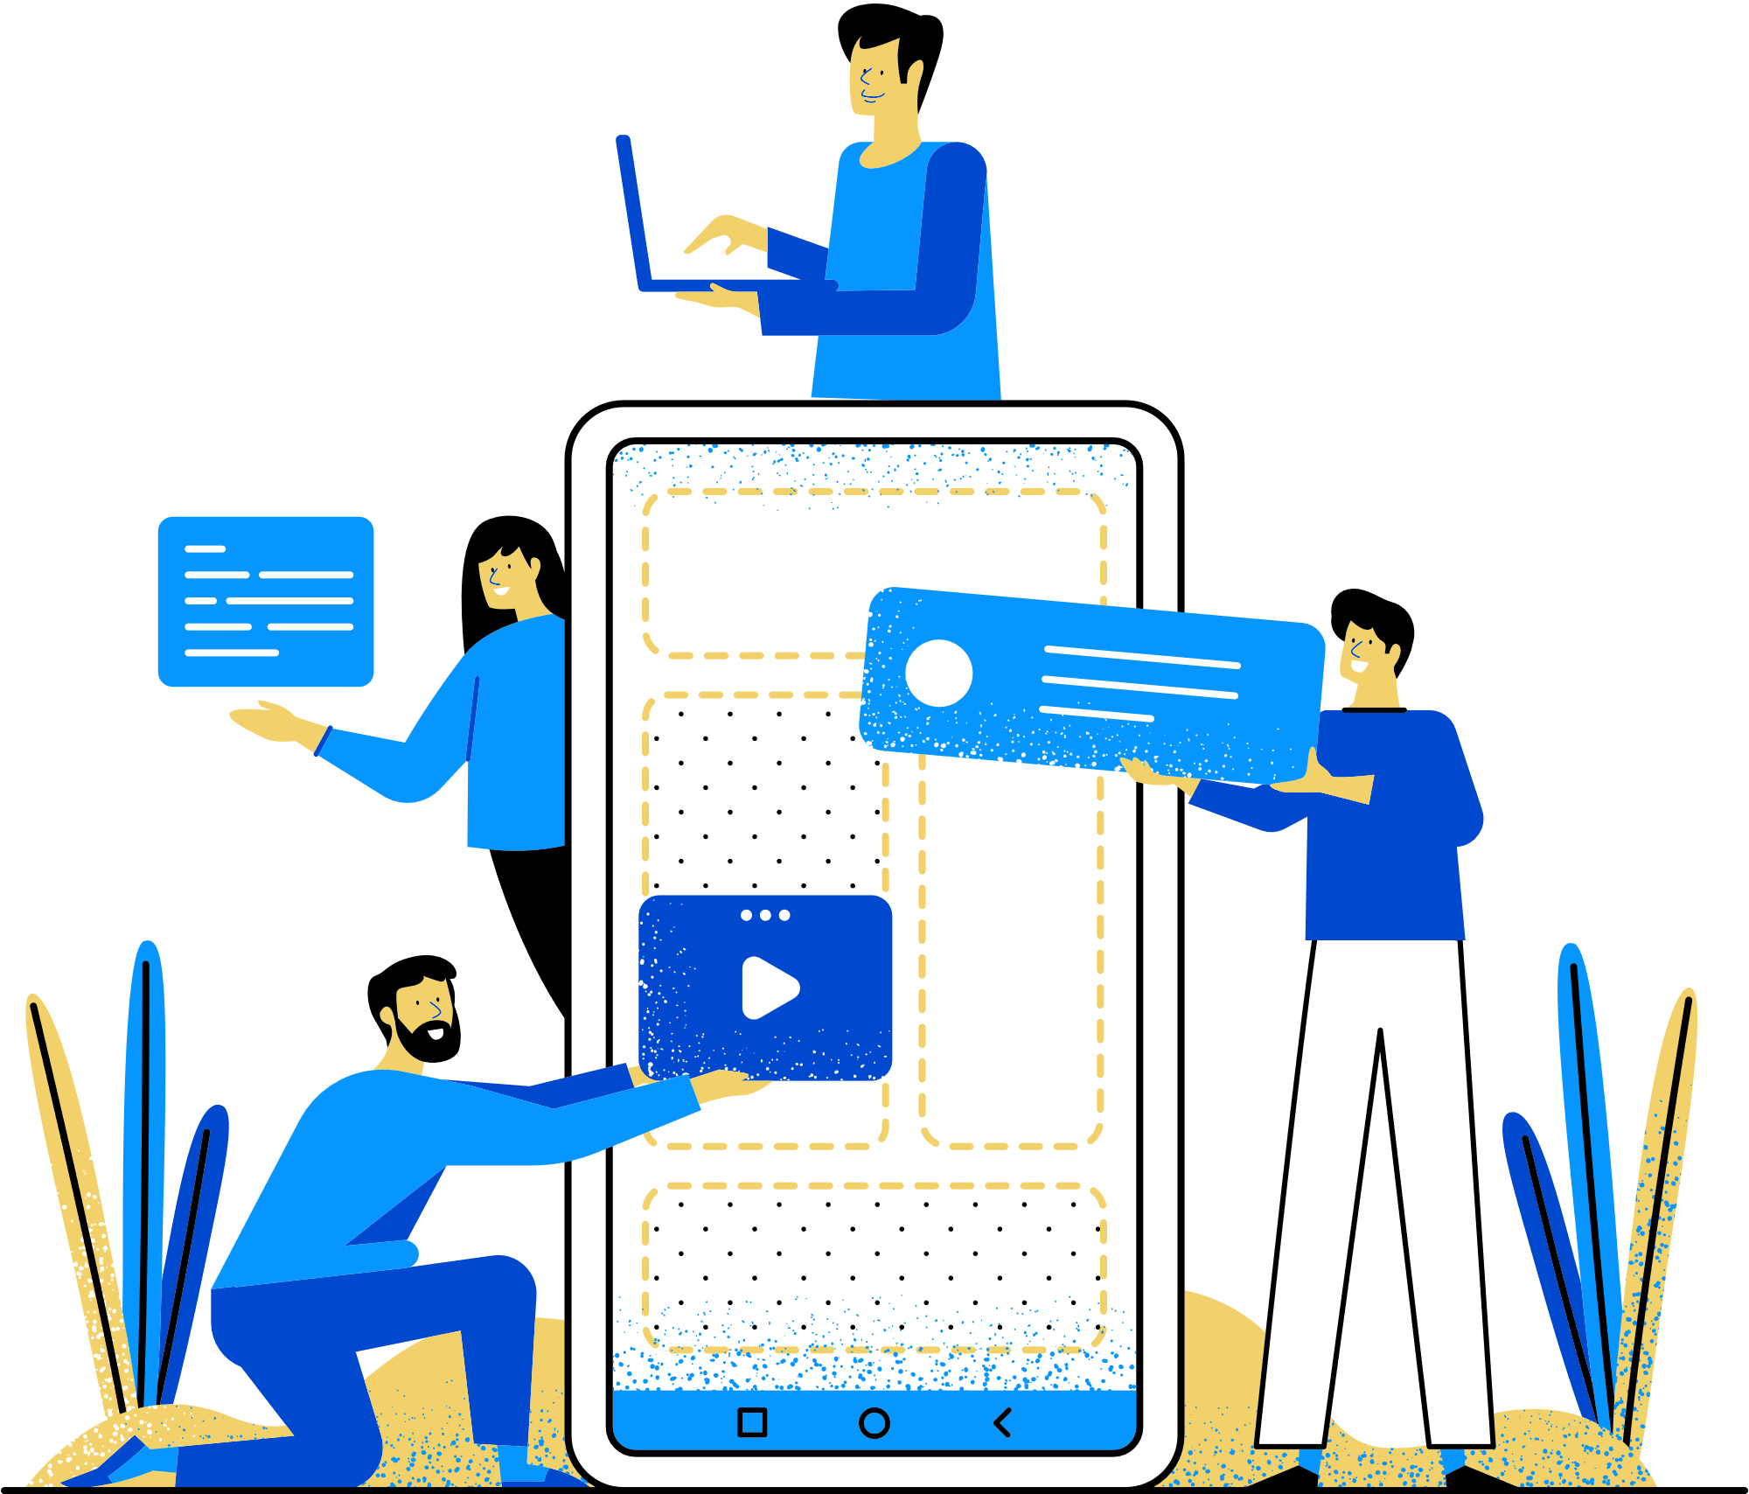
Thank You

